Slide 1

LNO Azure Refresh 2016
Azure Management concepts
Application Services 101
App Services Web Sites
DevOps with Azure and Team Services
API Apps Deeper dive

Slide 2
1 - Azure Management Concepts
Subscriptions & Role Based Access Control
Management Portals
Billing Portal
Classic Portal
“New” Azure Portal
Azure Resource Manager (ARM) automation
Support & Getting Help

Slide 3
2 - Application Services 101
App Services – Web, Mobile, API and Logic apps
Hosting Plans
Resources
Deployments
Settings
Monitoring
Scaling

Slide 4
2 - App Services Deeper Dive – Websites
VS Tools for Websites
Logging and Debugging
Application Insights
Continuous Integration
Kudu Management

Slide 5
3 - DevOps 101 with Azure and Team Svcs
DevOps overview
Managing Work
Working with code
Build & Test
Release Management
Extensions

Slide 6
4 – Mobile, API, Logic & Fn Apps Deeper Dive
What is a WebAPI
Building API’s
Deployment & Scale
API Management

Slide 7
Demos
Creating subscriptions
Management Portals
Resource Manager & Scripts

Slide 8
Learning Objectives
Azure.com
Portal.azure.com
Subscribe/activate
Enable Preview features
View pricing
Support
Change Subscriptions
Add Web App from gallery
Add VM from gallery
Explore settings & config
Help
Customize start board
Tile Gallery
Pin Favorites
Theme change
Search for service
Marketplace
View costs
Create support tickets
Manage.windowsazure.com

Slide 9
1A - Hello Azure

Slide 10
Software Challenges Today
$$$
Datacenter peak load
Usage
Idle time
Jan
Apr
Jul
Oct

Slide 11
What is Azure?
Public cloud offering from Microsoft
Runs in 38 data centers around the world
Enables customers to securely provision and use over 68 types of compute, storage and other services on demand
Supports auto scaling
Pay for what you use

Slide 12
Azure – Microsoft’s Public Cloud Offering
Comprehensive offerings including SaaS, IaaS and PaaS
Variety of offers from Free up to Enterprise purchase plans
68 Distinct service offerings in compute, storage and services
38 Announced major data centers around the world
50 Compliance offerings including ISO, CSA, ITAR and more
Hybrid capabilities for integration across integration, applications, identity and data
Open to whatever technology stack you choose

Slide 13
Typical Uses of Cloud Computing
Create new apps and services
Store, backup and recover data
Host websites and blogs
Ingest and analyze data from sensors and devices
Stream audio and video
Deliver software on demand
Analyze data for patterns and make predictions

Slide 14
Benefits of Cloud Computing
Cost – you pay for what you use and what you need
Speed – time to market as well as scaling options when you need it
Global Scale – deploy around the world when and where you need it
Productivity – instant provisioning without leadtimes
Performance – built on the latest generation of technology

Slide 15
Types of Cloud Services
Infrastructure as a Service (IaaS) – provision virtual machines on demand and create availability groups, network together to lift and shift compute workloads
Platform as a Service (PaaS) – focus on the apps and let Azure provide the machines, with easy scaling options
Software as a Service (SaaS) – deliver applications to customers at scale and with reliability and consistency

Slide 16
Types of Cloud Deployments
Public – running in data centers owned by third-party cloud service providers
Private – uses virtualization to enable provisioning of compute resources from an enterprise owned data center
Hybrid – leverages the public cloud to extend a private data center with features and reliability to absorb usage patterns like burst or cyclical businesses

Slide 17
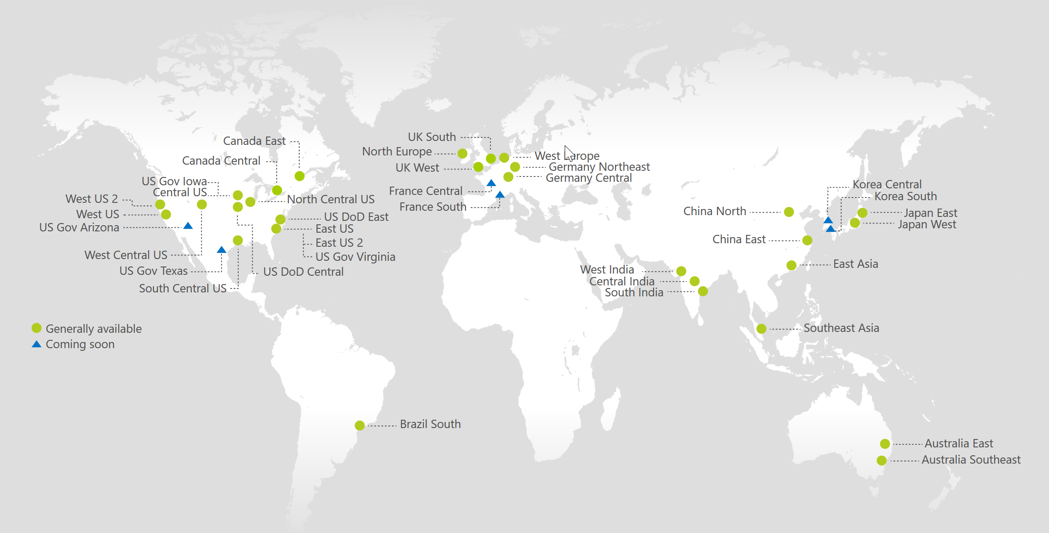
Azure 2017 – Data Centers
With 38 Azure Regions, More than Any Cloud Provider

Slide 18
>90,000
New Azure customer subscriptions/month
>1.5Million
SQL Databases running on Azure
>500Million
Users in Azure Active Directory
Azure momentum
1.5Trillion
Messages per month processed by Azure IoT
777Trillion
Storage Transactions per day
>40%
Revenue from Start-ups and ISVs
Notes:
>85% F500 customers on MS Cloud
>3,400 apps in Azure Marketplace
30 major certifications and attestations — more than any other major public cloud provider
13B authentications supported every week by Azure cloud services
1T messages a month are processed using Event Hub
>60B ingress events per day worldwide in Even Hub
More than 70T storage objects in Azure
More than 9M transactions per second processed by Azure Storage (nearly 3x growth YoY)
1.5M SQL DBs under management in Azure / Customer usage has increased 7x YoY
2.5B logins per week process to Azure SQL DB
External Traffic / web site hits (e.g. customer traffic only)- 83.46 billion hits/month
Total Sites/Apps (customer sites only) – 664k
3.4M Developers registered with Visual Studio Online

Slide 19
2014 – 300 new features 2015 – 500 new features 2016 – ### new features!
Zumo
Event Hub
Mobile Apps
ARM Scripts
ARM Scripts
Slots
Service Fabric
Azure AD B2C
Automation
Functions
Docker
Web Jobs
Application Insights
Express Route
Stream Analytics
Deployment
Machine Learning
IoT Hub

Slide 20
Where to Get Started
Visit Microsoft’s Azure web site to get
Product details
Documentation
Pricing
Security & Compliance details
Find partners and resources
Go to www.azure.com to learn more!

Slide 21
1B - Subscriptions

Slide 22
Azure Subscriptions
An enrollment for Online Services for a defined Term as specified on the Portal
You may purchase multiple Subscriptions, which may be administered separately and which will be governed by the terms of a separate Microsoft Online Subscription Agreement
Owned by an individual or an organization
Enables provisioning of services within an Azure data center

Slide 23

Azure Subscriptions
Azure Free Account
$200 Credit for first 30 days
Access to free tier of services after 30 days
Cap prevents overage
Azure Benefits
MSDN : Up to $150/mo credit
BizSpark Plus : From $150/mo to $10,000/mo credit
Academic offers
Visual Studio Community + $25/mo for 1 year
Pay as you go
www.azure.com/free

Slide 24


Security and Administration
Microsoft Accounts
Support Co-admin of all resources in subscription
Simple to admin in classic Azure portal
Azure Active Directory
Works with classic and modern Azure portals
Works with Azure Resource compatible services to support Role Based Access
Identity and Access Management (IAM)
Enables per service/per role authorization
Simple configuration
Requires Active Directory

Slide 25
Azure Active Directory
General
Overview
Quickstart
Manage
Users and Groups
Enterprise Applications
App Registrations
Application Proxy
Azure AD Connect
Domain Names
Mobility (MDM and MAM)
Password Reset
Company Branding
User Settings
Properties
Notification Settings
Conditional Access
Named Networks
Activity
Sign-ins - Audit Logs
Security
Users at Risk
Risky Sign-ins

Slide 26
Subscription Options
General
Overview
Access Control
Diagnose and solve
Billing
Invoices
Cost analysis
External Services
Payment methods
Partner info
Email my invoice
Settings
Programmatic Deployment
Resource Groups
Resources
Usage + Quotas
Management certificates
My permissions
Resource providers
Properties
Resource locks
Support + Troubleshooting
New support request

Slide 27
Provision subscription
Setup RBAC
Create user & login
Show dashboard

Slide 28
1C - Portals

Slide 29
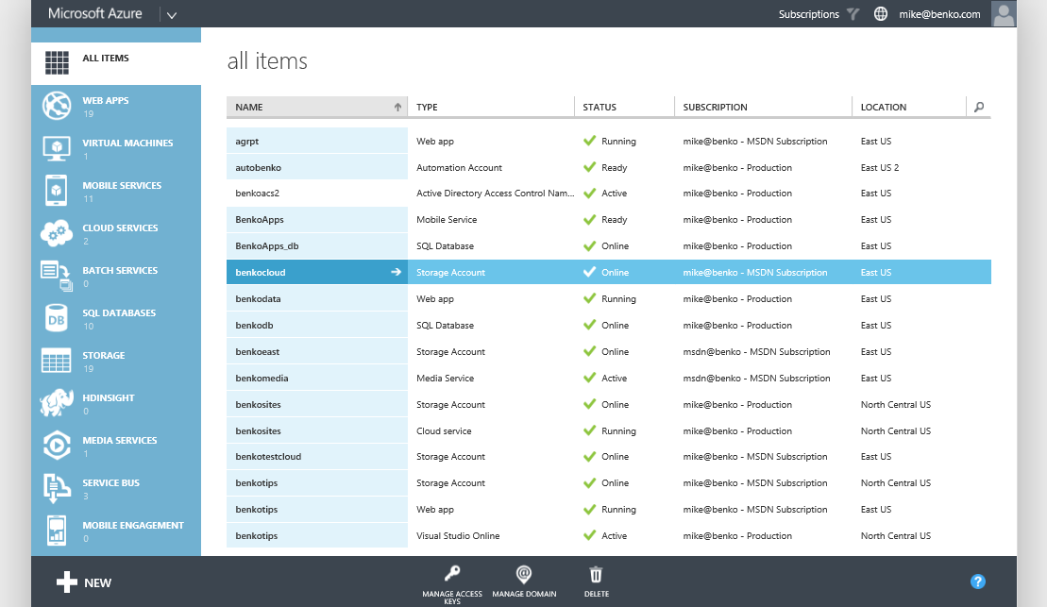
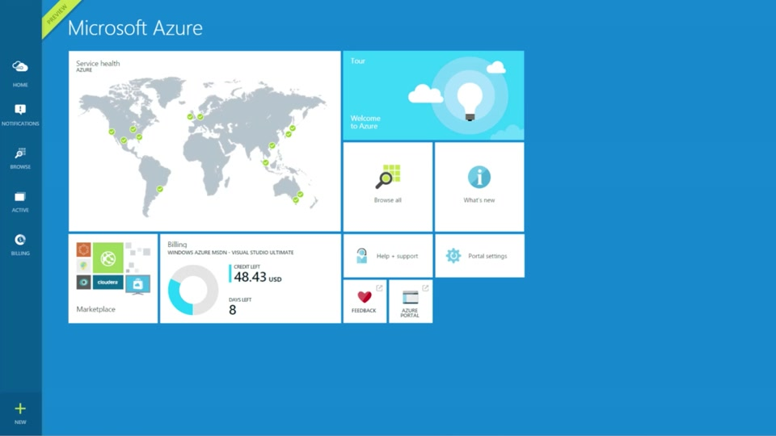
Get Started – Management Portals
manage.windowsazure.com
portal.azure.com
Subscription centric
Visibility of all resources
Contextual toolbars
Consistent create
Help system
Highly customizable
Search, Blades, and Lenses
Resource grouped provisioning
Role based access control (RBAC)
Advanced monitoring and troubleshooting
Self service ticketing

Slide 30
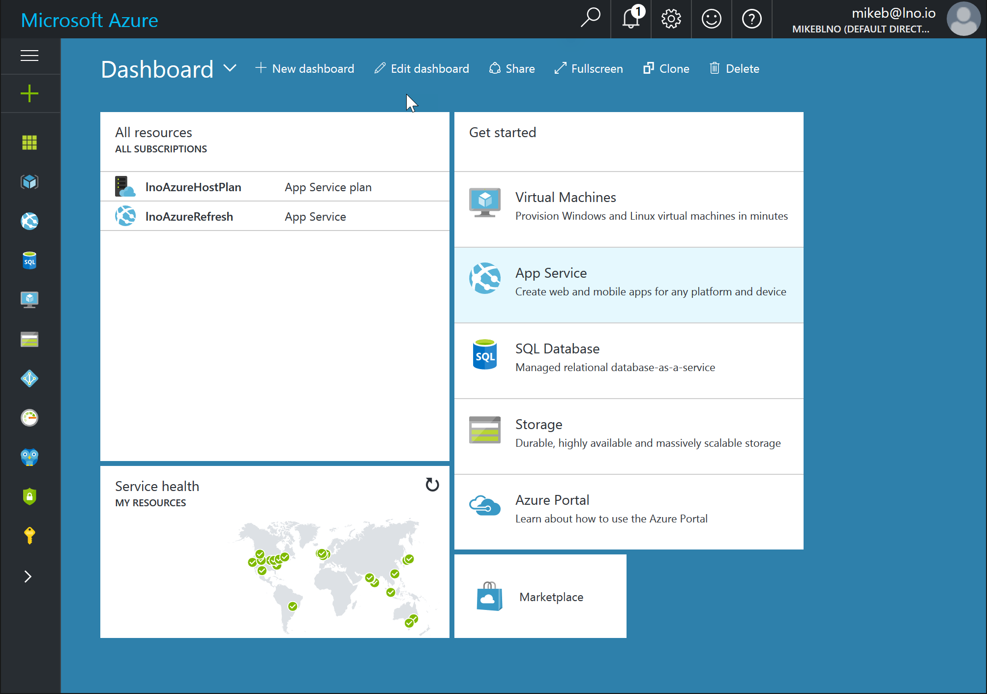
Modern Azure Portal
Blades are a vertical partition of content currently being viewed
Additional levels of detail can be drilled into with additional blades added to right
Customizable dashboard views allow you to pin what you need where you want it
Powerful search enables you to find anything by name or by type
Support provisioning with ARM
http://portal.azure.com

Slide 31
Understanding Azure Resources
App Services
Web, Mobile, Logic, or Flow Apps
App Service Plans
Managed compute infrastructure for your App Services
Hosting configuration
Resource Groups
Logical containers for organizing and managing Azure resources

Slide 32
Azure Resource Manager
JSON based service definition
Scriptable via PowerShell, .NET and other tools to provision services with specific settings
Repeatable!
New Portal is ARM focused as well as RBAC enabled

Slide 33
Classic Portal
New Portal
Preview Portal

Slide 34
2A - App Services101

Slide 35
What are App Services?
VM’s are heavy weight and cumbersome. Isn’t there an easier way to do PaaS?
Reality
App Services provide an easy way to create and deploy web based applications
Quickly create from templates, the gallery or from Visual Studio
Deployment slots allow for staged delivery of new versions of the application
Get started at www.Azure.com/Free

Slide 36
What is an Azure App Service?
Platform as a Service (Paas)
A scalable system architecture that uses compute instances in Azure to implement core features of a solution – KUDU
Endpoints that are load balanced
Dynamically scalable
Driven by configuration

Slide 37

Application Services
Web Apps
Mobile Apps
Web apps that scale with your business
Build Mobile apps for any device
LOGIC Apps
API Apps
Automate business process across SaaS and on-premises
Easily build and consume APIs in the cloud

Slide 38
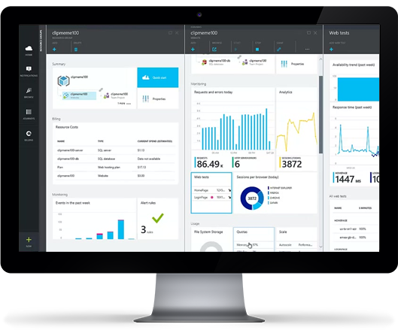
Web Apps That Scale
Code in your favorite language and IDE – .NET, NodeJS, PHP, Python, or Java – to build web apps and APIs faster than ever
Be more agile with continuous integration using Visual Studio Team Services or GitHub and with live-site debugging
Easily scale applications on-demand with high availability

Slide 39
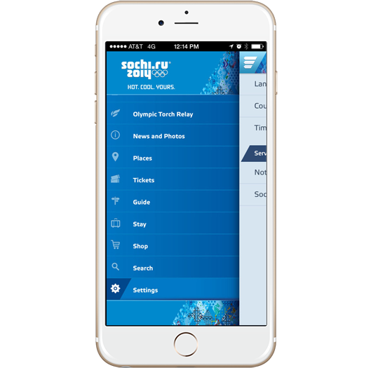
Engaging Mobile Apps
Build engaging mobile apps for iOS, Android, and Windows
Easily add corporate sign-on, and securely connect to on-premise resources
Create robust apps that remain useful when there are network issues, so users can create and modify data even when they are offline
Broadcast personalized push notifications to millions in minutes

Slide 40


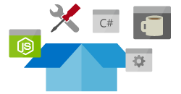
API Apps That Connect
Quickly build and consume APIs in the cloud using the language of your choice
Secure APIs with Active Directory, single sign-on, and oAuth
Generate client proxies or APIs in your language of choice
Mashup existing enterprise APIs
Integrate with API Management and Logic Apps

Slide 41
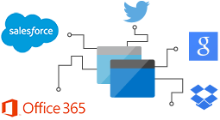

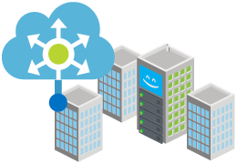
Workflow Logic Apps for Integration
Create business processes and workflows visually
Deliver integration capabilities in web, mobile, and API apps
Integrate with your SaaS and enterprise applications
Automate EAI, B2B, and business processes
Connect to on-premises data

Slide 42
Understanding Azure Resources
App Services
Web, Mobile, Logic or Flow Apps
App Service Plans
Managed compute infrastructure for your App Services
Hosting configuration
Resource Groups
Logical containers for organizing and managing azure resources

Slide 43
How to Provision a Web App
Visual Studio
Using the Azure 2.x SDK tools installed you can provision and deploy to an Azure Web App Service
“Classic” management portal
http://manage.windowsazure.com
“New” resource management portal
http://portal.azure.com

Slide 44
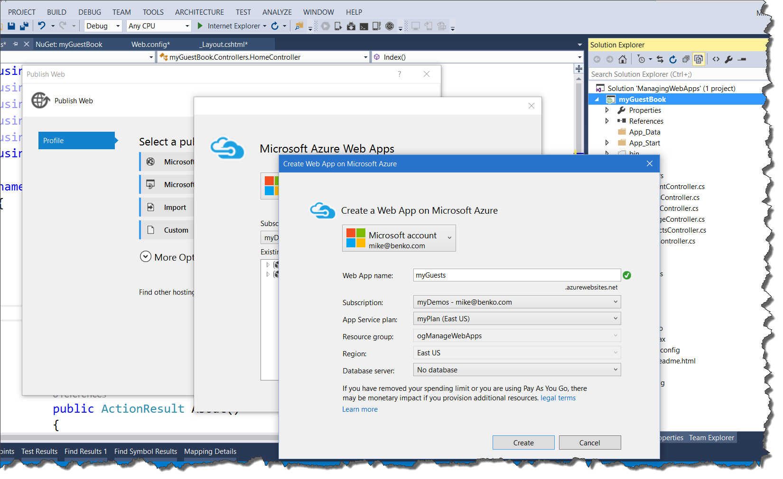
Creating a Web App – Visual Studio
Using Visual Studio
From the project in Visual Studio right click and go to Publish.
You can create new Web Apps or use existing ones

Slide 45
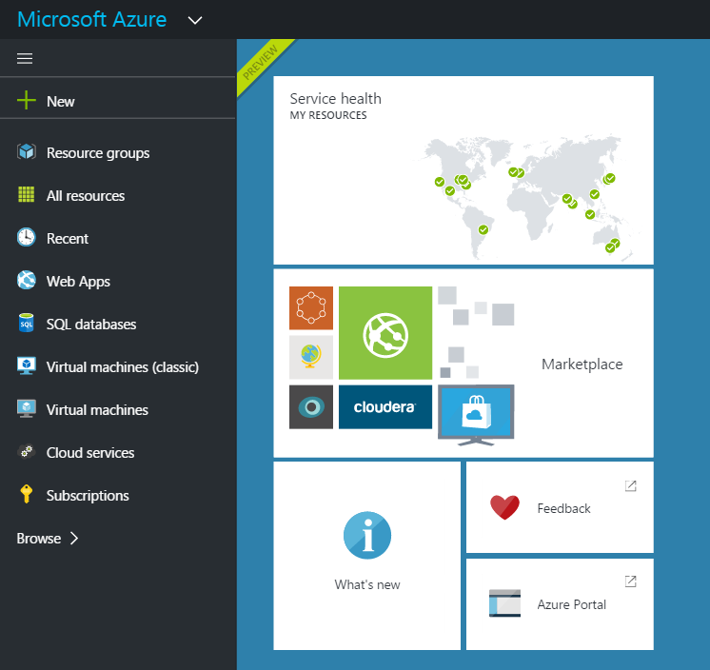
Creating a Web App
Using Azure Management Portal – http://portal.azure.com
Create an empty website or a solution made up of multiple resources
Uses “Resource Groups” to group resources that share the same lifecycle for management

Slide 46
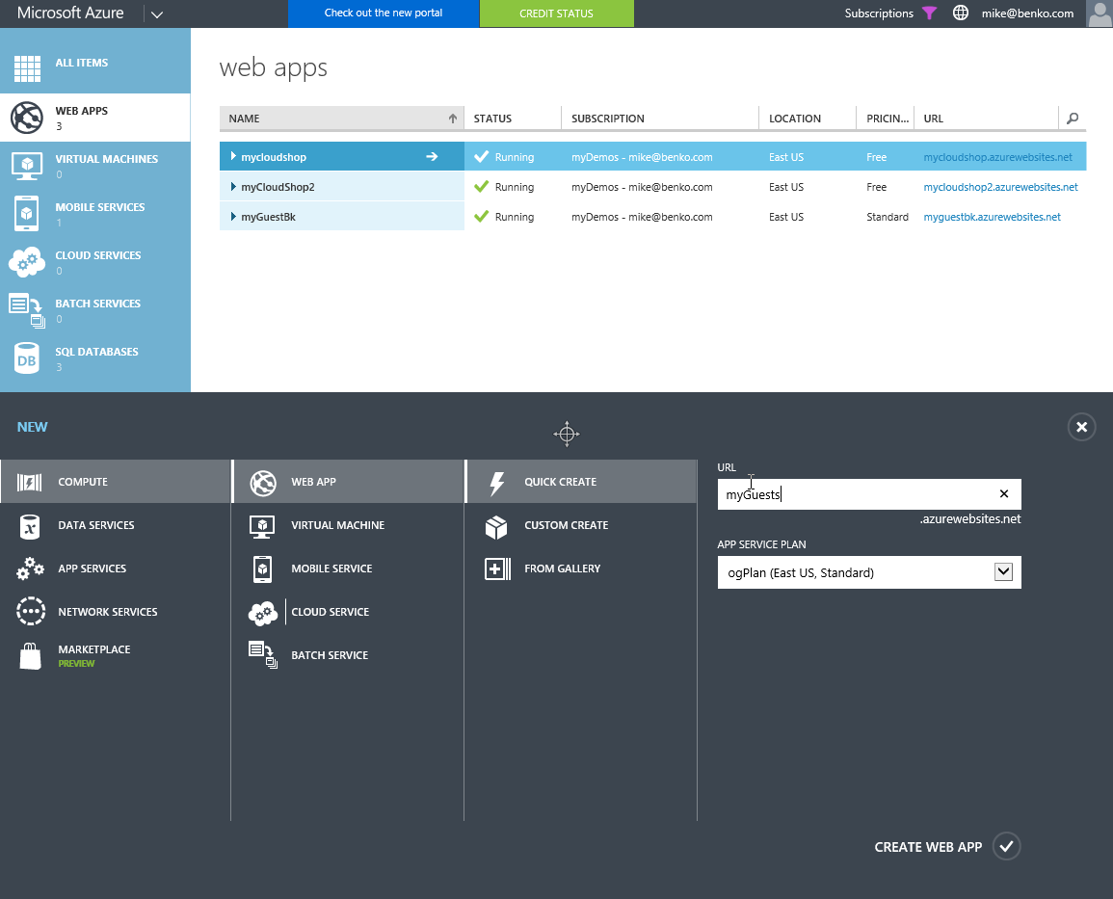
Creating a Web App – Classic Portal
Classic Management Portal – https://manage.windowsazure.com
Create a basic Web App
Uses defaults for Resource Group
Little choice of service plan options

Slide 47
Web App Portal – Tools & Configuration
General
Overview
Activity Log
Access Control (IAM)
Tags
Diagnose & Solve Problems
App Deployment
Quickstart
Deployment credentials
Deployment Slots
Deployment Options
Continuous Delivery (Preview)
Settings
Application Settings
Authentication (ACS)
Backups
Custom Domains
SSL Certificates
Networking
Scale Up
Scale Out
Security Scanning
Web Jobs
Push
MySQL In App (Preview)
Properties
Locks
Automation Script
App Service Plan
App Service Plan
Quotas
Change App Service Plan
Development Tools
Clone App
Console
Advanced Tools (Kudu)
App Service Editor (Preview)
Performance test
Resource explorer
PHP Debugging
Testing in Production
Extensions
Mobile
Easy Tables
Easy API’s
Data connections
API
API Definitions
CORS
Monitoring
Application Insights
Alerts
Diagnostic Logs
Log Stream
Process Explorer
Metrics per instance (Apps)
Metrics per instance (Svc)
Live HTTP Traffic
Application Events
FREB logs
Support + Troubleshooting
Resource Health
App Service Advisor
Failure History
Diagnostics as a Service
Mitigate
New Support request

Slide 48
App Service Provisioning

Slide 49
2B - Settings

Slide 50
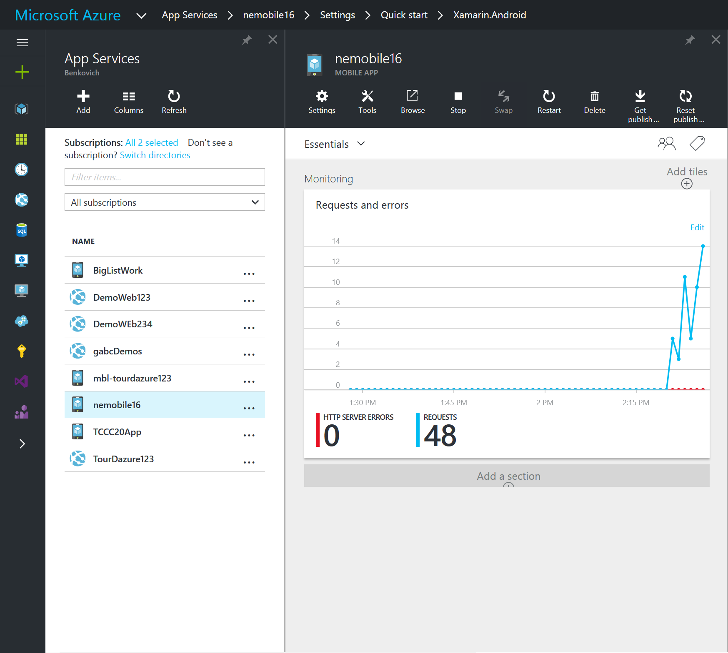
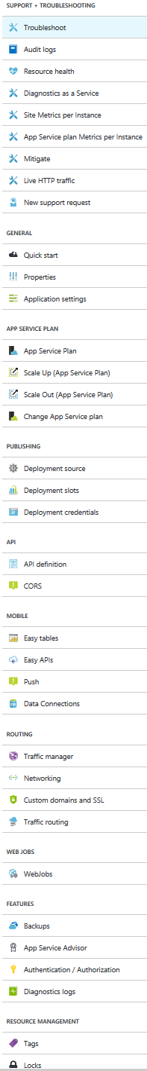
Azure Web App Settings

Slide 51
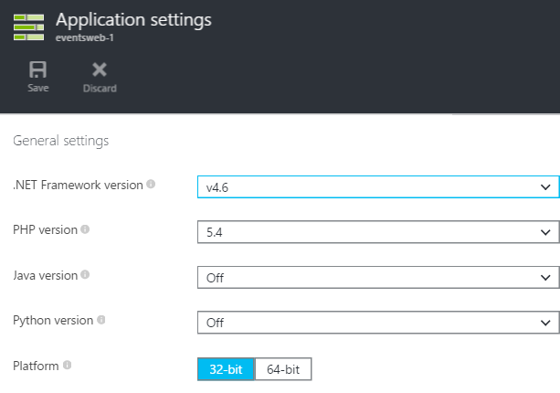
Framework and Platform Settings
Frameworks
.NET Framework
PHP
Java
Python
Platform
32/64 bit

Slide 52
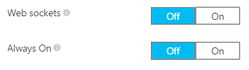
Web Sockets and Always On
Web Sockets
Integrate real-time communication scenarios (i.e. chat)
SignalR and Socket.io libraries supported
Always On
Keeps your website active (warm)
Standard mode websites only
Recommended if you have continuous web jobs

Slide 53
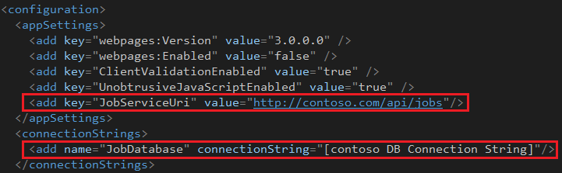
App Settings and Connection Strings
Configuration Files
Traditionally application settings and connection strings are stored in web.config
Sections (such as connection strings) of web.config encrypted to protect sensitive information

Slide 54
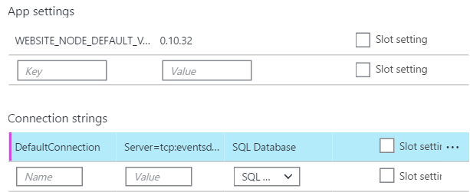
App Settings and Connection Strings
Website Settings
Application settings and connection strings can also be defined in the web app settings
Slot Settings
Settings that are specific to a deployment slot such as DB connection strings or Azure AD settings

Slide 55
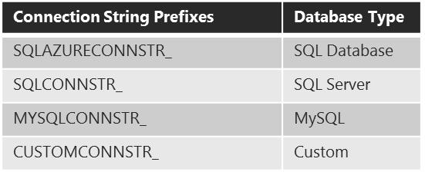
App Settings and Connection Strings
Retrieve as Environment Variables
Retrieve as Key/Value from ConfigurationManager

Slide 56
Application Settings

Slide 57
2C - Hosting Plans & Scale

Slide 58
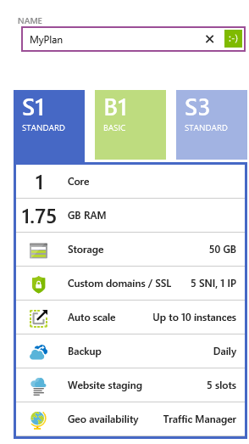
App Hosting Plans
App hosting plans represent a set of features and capacity that you can share across your web apps
You can have multiple plans to support deployments of separate tiers of features and capabilities

Slide 59
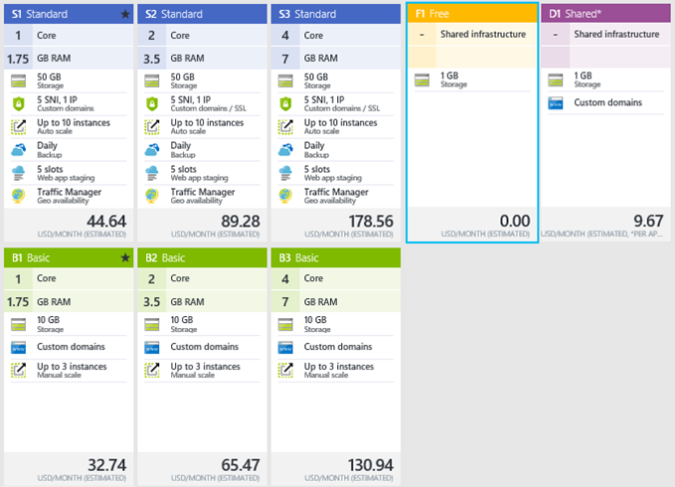
App Service Plans
App Service Plans represent a set of features and capacity that you can share across your web apps
You can have multiple plans to support deployments of separate tiers of features and capabilities

Slide 60
Service Plan Categories
Shared (F1, D1)
Basic (B1, B2, B3)
Standard & Premium
1 GB Storage
Custom domains
10 GB Storage
Custom domains
Scale up to 3 instances
+ More Storage
Custom domains
SSL
Auto Scale up to 10
Backups
Deployment Slots
Traffic Manager

Slide 61
Website Architecture
Web App (w3wp.exe)
SQL
Database
All DB’s are SQL Database
Azure Blobs as Durable Storage
Microsoft Azure Worker Roles
Monitor Resource Usage
Dynamic Web Activation Service
W3WP.exe IIS Application Pool Process
IIS ARR (LB)
Web App (w3wp.exe)
MySQL
Web
Servers
Runtime DB
Web App (w3wp.exe)
Azure LB
Metering
Deployment
Servers
DWAS
Storage Controller
Mgmt API
Cloud Drive

Slide 62

Scale
Free
Multi-tenant. Daily quotas
Shared
Multi-tenant. Daily quotas
Standard
Dedicated VMs. No quotas
For more information on web apps options:
http://azure.microsoft.com/en-us/pricing/details/web-sites/

Slide 63
Hosting Plans
Scale Up
Scale Out

Slide 64
2D - Deployments

Slide 65

Publishing Websites
FTP://
FTP
FTP Client (i.e. FileZilla)
Visual Studio
Web Deploy
Visual Studio
Continuous Integration
Usually Automated via Service Hooks
WebDeploy

Slide 66
Publishing Files to Azure Web Apps
Three methods for publishing content to Web Apps
WebDeploy
FTP
Git
Requires the publisher (developer or tool) to first authenticate
These methods don’t support authentication using Microsoft Accounts, which means new publishing/deployment credentials need to be created

Slide 67
Web App Deployment Credentials
User-Level Credentials (Deployment Credentials)
Directly tied to your Microsoft Account/Live ID
Unique for each Admin/Co-Admin on the Azure Subscription
Should never be shared between users
The same for all web apps in your subscription
Site-Level Credentials (Publish Profile Credentials)
Automatically generated for each website
Same for each admin/co-admin on the Azure Subscription
Can be found by downloading the publish profile for the web app

Slide 68
Using Deployment Credentials
User-Level Credentials (Deployment Credentials)
Using an FTP Client (i.e. FileZilla)
Doing a Git push from your local repository
Logging into the Site Control Manager (SCM) site
Site-Level Credentials (Publish Profile Credentials)
Intended to be use by programs that are deployments on your behalf

Slide 69
Staged Publishing
Publish updates to website into the staging deployment slot
Run and test in the staging slot
Instantly swap the staging and production slots
“Go Live”
“Oops!”

Slide 70
Automating Website Deployments
Publishing with Command Line Tools
MSBuild
FTP Scripts
PowerShell
Cross-Platform Command Line Interface (CLI)
Publishing from Source Control
Generally to a staged deployment slot

Slide 71
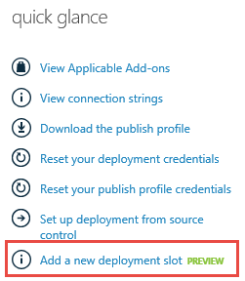
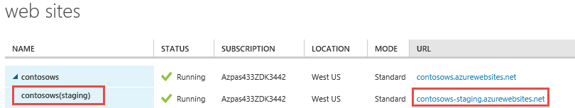
Deployment Slots
A separate website linked to your primary website
Each deployment slot has its own URL and runtime environment

Slide 72







Publishing from Source Control
Supported Options
Git or Mercurial repositories are supported.

Slide 73
Deployment
Continuous Deployment
Slots

Slide 74
2E - Monitoring

Slide 75
Monitoring App Services
Alerts Notification of Error Conditions
Diagnostics Logs Settings of what to Monitor and Storage
Log Stream Live View of Monitoring
Process Explorer Host Process Details
Metrics Performance Counters

Slide 76
Alerts
Endpoint Monitoring Metrics
Response Time Metric for each test location
Uptime Metric for each test location
Each Metric can be added to the Dashboard and Monitor pages in the portal
Alert Rules
A rule can be defined for each metric
Notifications
Email Service Admin and Co-Admin
Provide an email address to send alert to

Slide 77
Site Diagnostic Log Files
Log File Targets
File System (Shared Cloud Drive)
Azure Blob Storage
Web Server Log
File System or Azure Blob Storage
Detailed Error Messages & Failed Request Tracing
File System Only
Contoso
Website
Shared Cloud Drive
Contoso
Website
Azure Blob Storage

Slide 78
Site Diagnostic Log Files
Web Server Log
D:\home\LogFiles\http\RawLogs
Detailed Errors Log
D:\home\LogFiles\DetailedErrors
Failed Request Log
D:\home\LogFiles\W3SVC<Uniqueld>
Event Log (xml)
D:\home\LogFiles\eventlog.xml
Unhandled exceptions and other events generally logged to the Windows Application Event Log

Slide 79
Application Diagnostic Log Files
Log File Targets
File System
Azure Blob Storage
Azure Table Storage
Logging Levels
Error
Warning
Information
Verbose
Contoso
Website
Shared Cloud Drive
Contoso
Website
Azure Blob Storage
Contoso
Website
Azure Table Storage

Slide 80
Live Streaming Diagnostic Log Files
View diagnostics data real-time (almost) without downloading diagnostic logs
Live-Streaming also streams data written to any .txt file in the D:\home\LogFiles directory
Tool Support
X-Platform Command Line Interface (CLI)
Azure PowerShell Cmdlets
Visual Studio (Server Explorer)

Slide 81
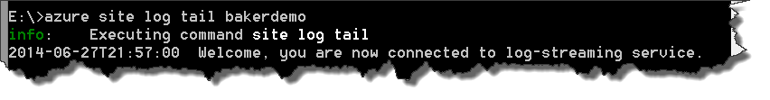
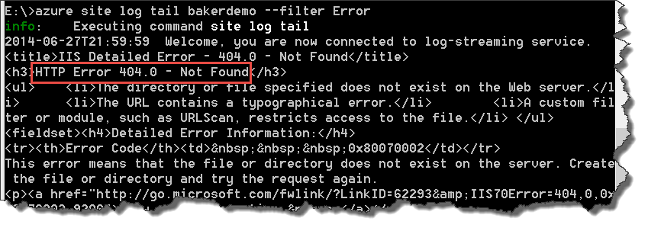
Live Streaming Diagnostic Log Files
X-Platform CLI Tools
Enable Log-Streaming
Enable Log-Streaming with a Filter

Slide 82
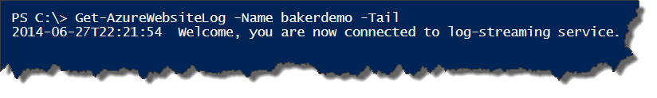
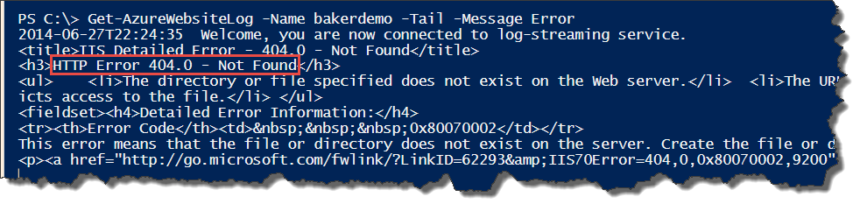
Live Streaming Diagnostic Log Files
Enable Log-Streaming
Azure PowerShell Cmdlets
Enable Log-Streaming with a Filter

Slide 83
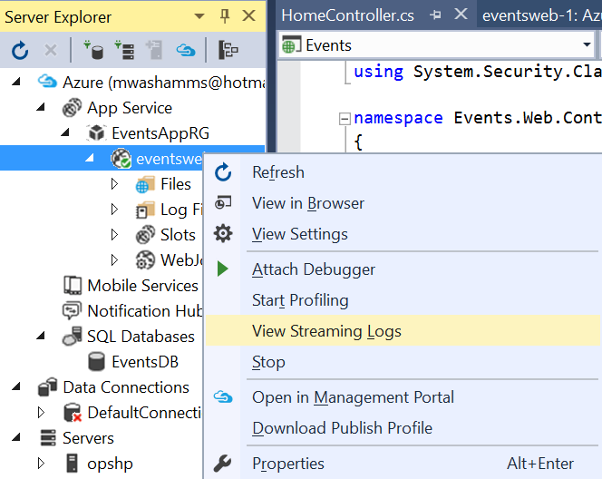
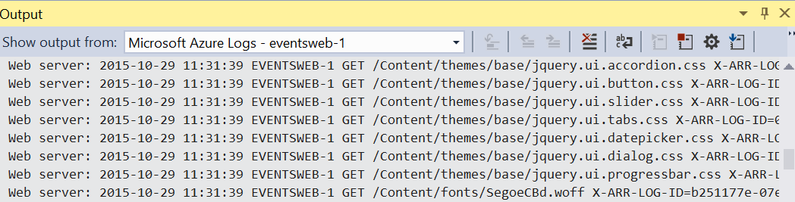
Live Streaming Visual Studio
Enable Log-Streaming

Slide 84
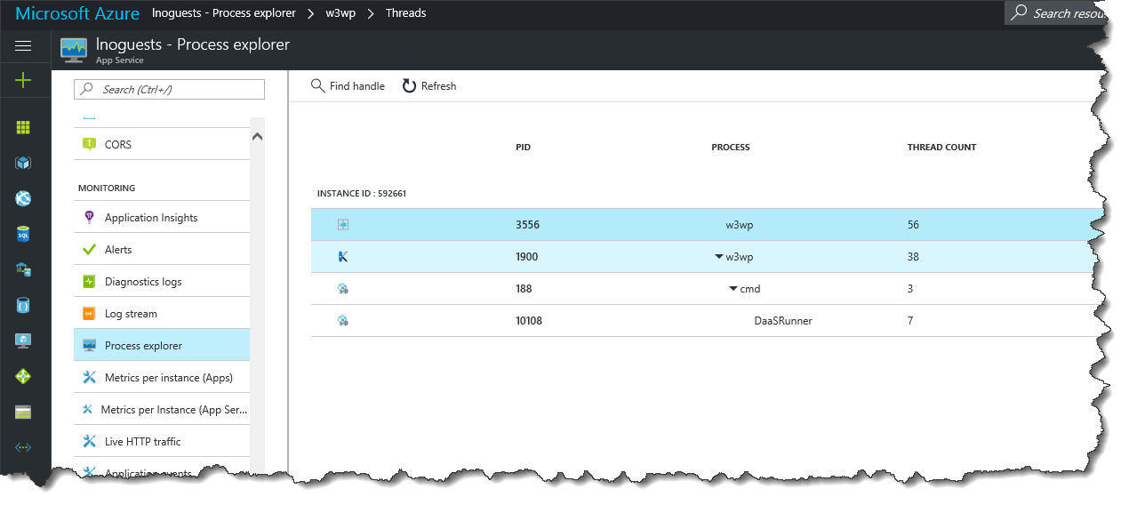
Process Explorer
Performance of web app
Drill into details
Handles
Thread
Modules
Memory

Slide 85
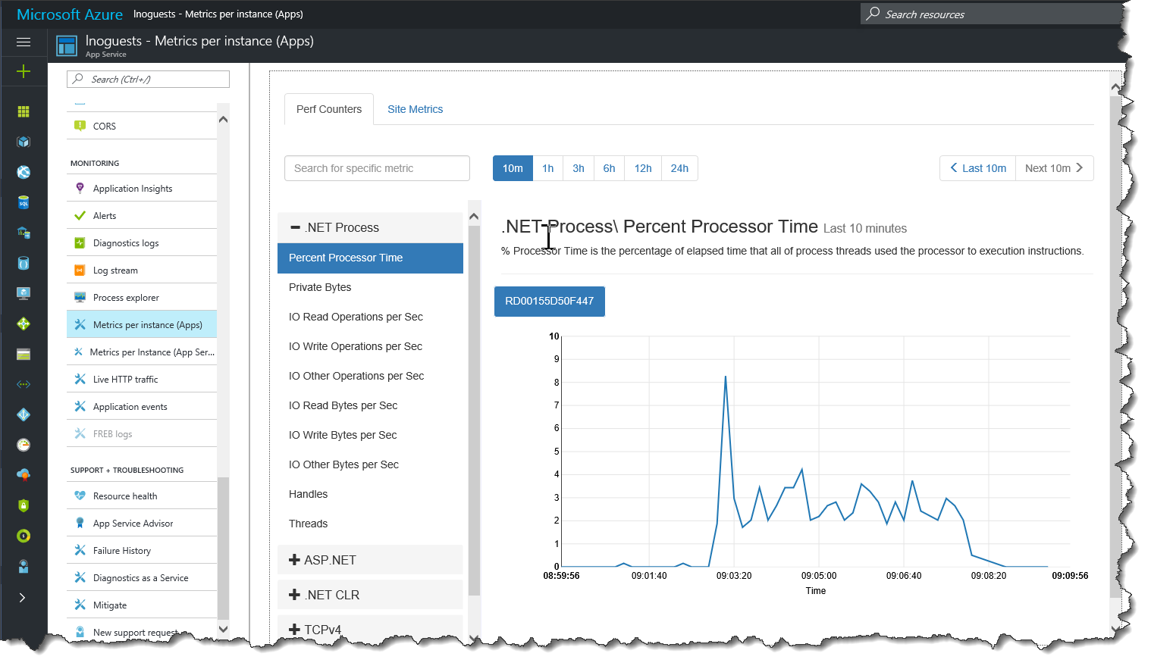
Metrics
Performance Counters
Per App, App Service
Live traffic
Application Events

Slide 86
Alerts
Diagnostic Logs
Streaming Logs
Process Explorer
Metrics

Slide 87
2F - Application Insights

Slide 88
Application Insights
General
Overview
Activity Log
Access Control (IAM)
Investigate
Application Map
Smart Detection
Live Metrics Stream
Availability
Failures
Performance
Servers
Browser
Usage
Configure
Sign-ins - Audit Logs
Properties
Alerts
Quota + Pricing
Features + Pricing
Continuous export
Performance Testing
API Access
Work Items
Security
Locks
Automation Script
New support request

Slide 89
Application Insights
Analytics repository and SDK’s to capture info
Deep information analytics to performance characteristics
Works with a variety of platforms including .NET, Node.js and J2EE, hosted on-premise or in the cloud
Integrates with DevOps processes

Slide 90
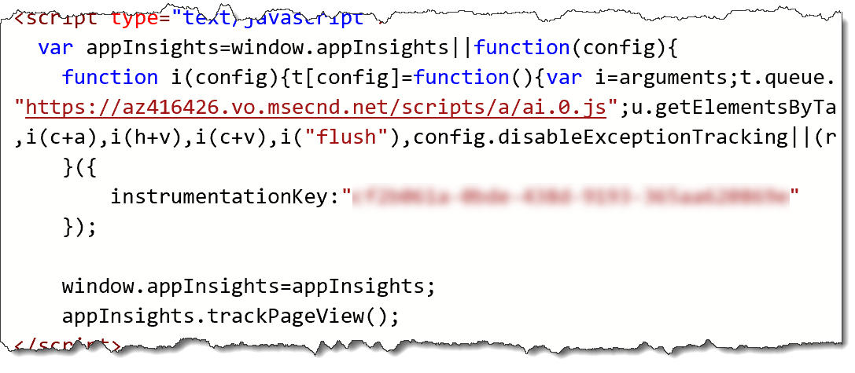
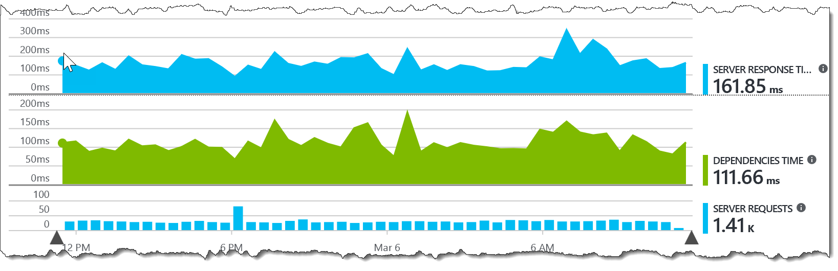
Application Insights and App Services
Simple integration as App Service extension
Add/configure in Visual Studio
Enable per page detail with script

Slide 91







Application Insights - Investigate
Usage Sessions, Users & Page Views
Application Map Dependencies and connections
Smart Detection Warning of potential problems
Live Metrics Stream Charts updated live
Availability Response time & web tests
Failures Insight to exceptions
Performance Server response times

Slide 92
Application Insights

Slide 93
2G - Debugging

Slide 94
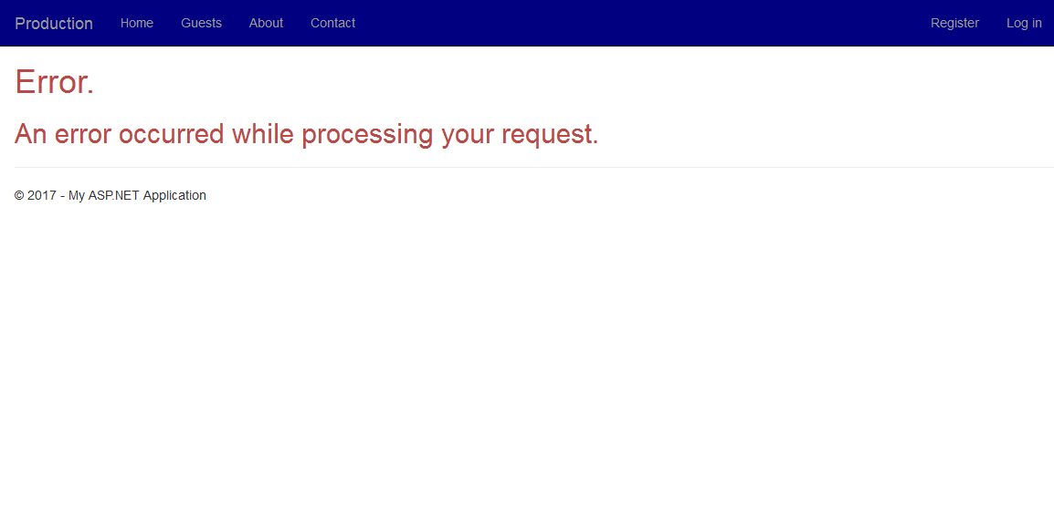
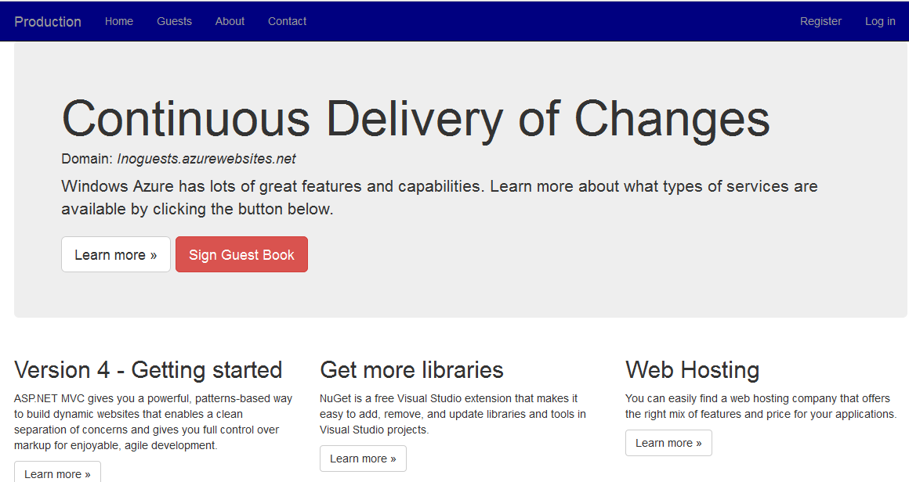
When Things Go Wrong
Need visibility to the hosting service
Azure portal
Streaming logs
Investigate with Kudu
View code
Process info
Remote debugging
Visual Studio

Slide 95

Kudu
The Engine Behind the Features in Azure App Services
http://myapp.scm.azurewebsites.net
Enables Deployment from Source Control
Service settings, files and more!
Web Hooks
Azure Site Extensions
WebJobs

Slide 96

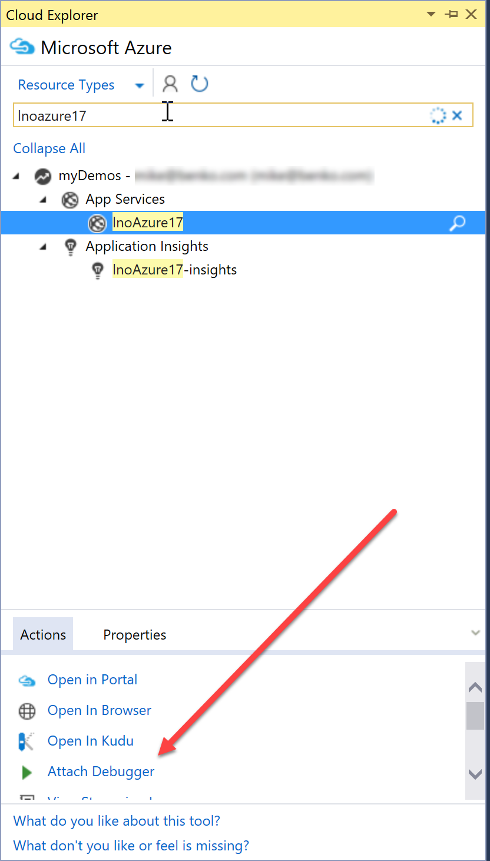
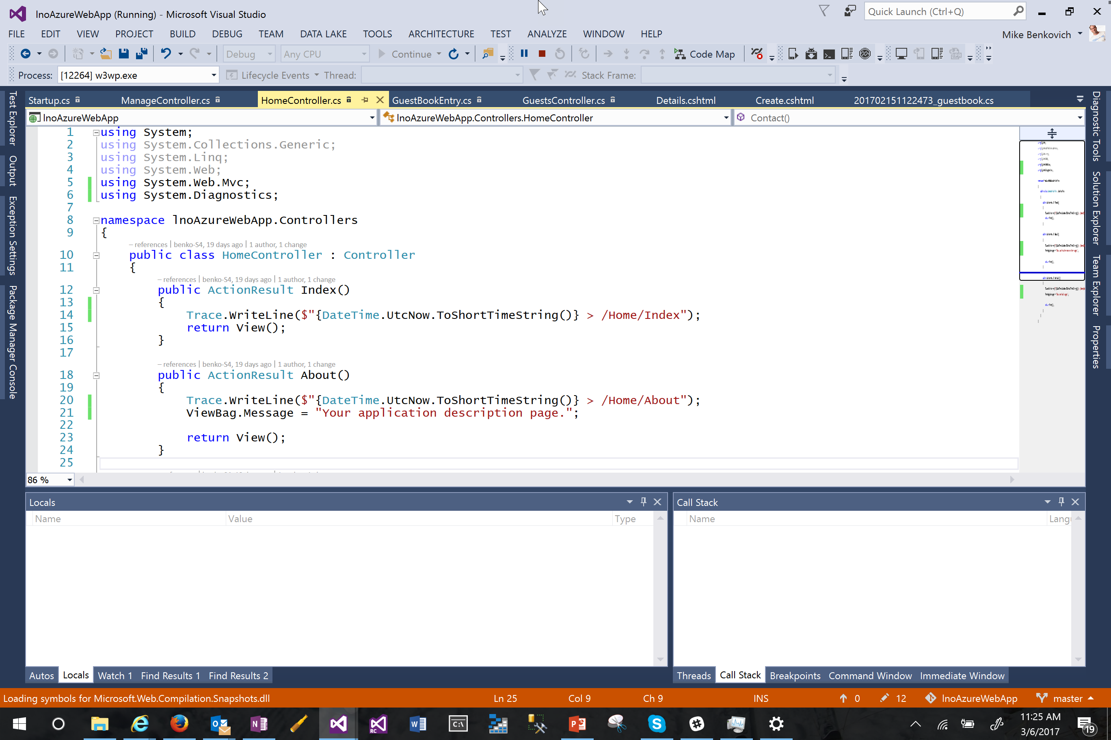
Debugging App Services
Visual Studio
Server Explorer
Cloud Explorer
Attach Debugger
Full fidelity debug experience
Step thru code
Requirements
Debug build deployment
Authorization of your user to site

Slide 97
Kudu
VS Debug

Slide 98
3A DevOps 101

Slide 99
DevOps?

Slide 100
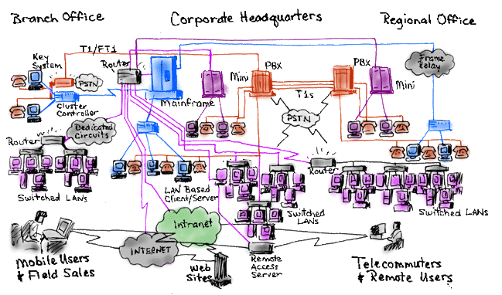

Slide 101




DevOps = Dev + Ops?
Plan + Track
Monitor + Learn
Development
Production
Develop + Test
Release

Slide 102
“DevOps is the union of people, process, and products to enable continuous delivery of value to our end users.”
http://bit.ly/WhatIs-DevOps

Slide 103







+ Cloud =

Slide 104

Visual Studio Team Services
Code Repository
Build + Deploy
Automated Testing
User Feedback
Backlog
Monitor and improve

Slide 105
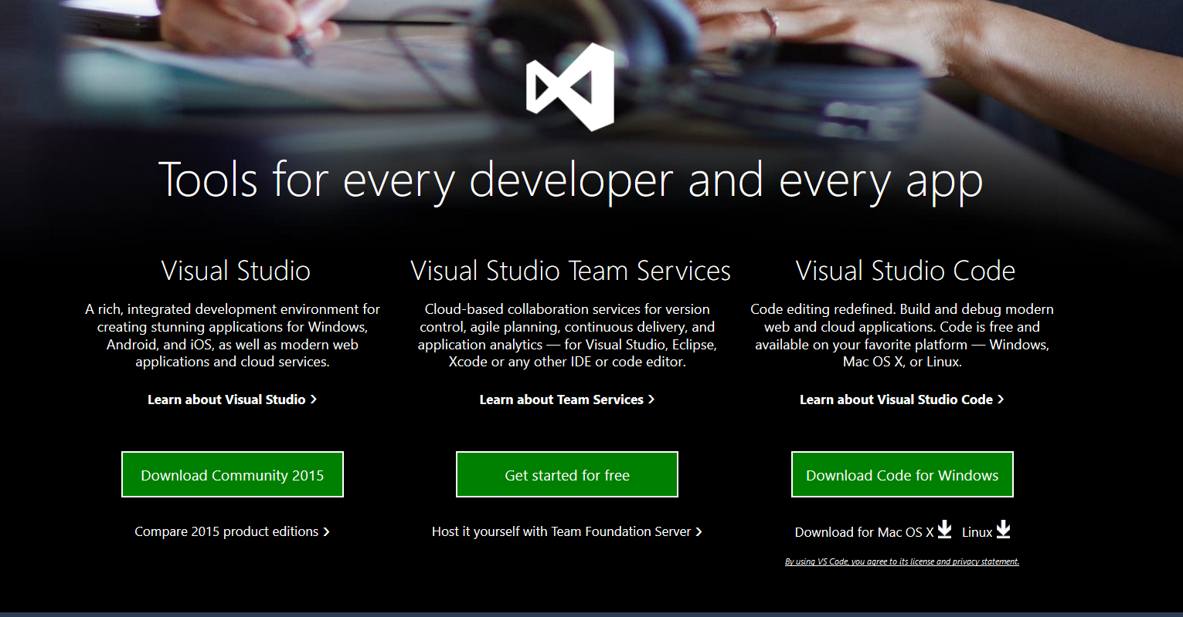
Getting Started with Team Services
Sign up at www.VisualStudio.com
Cloud based collaboration services
Version Control
Agile planning
Continuous delivery
5 Free “Basic” users
Unlimited “MSDN” users

Slide 106
3B – Work Backlog

Slide 107
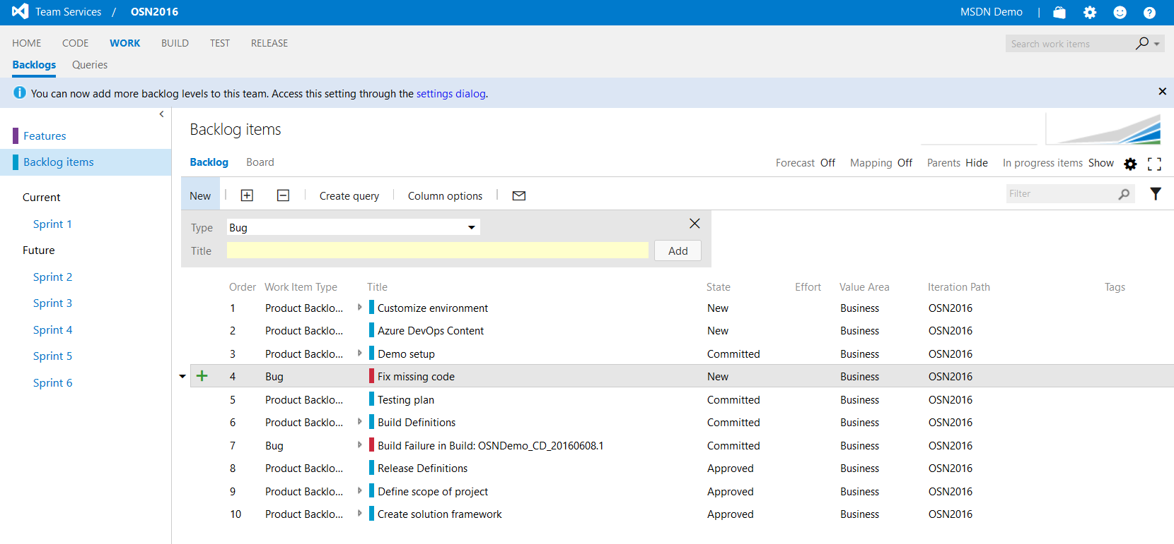
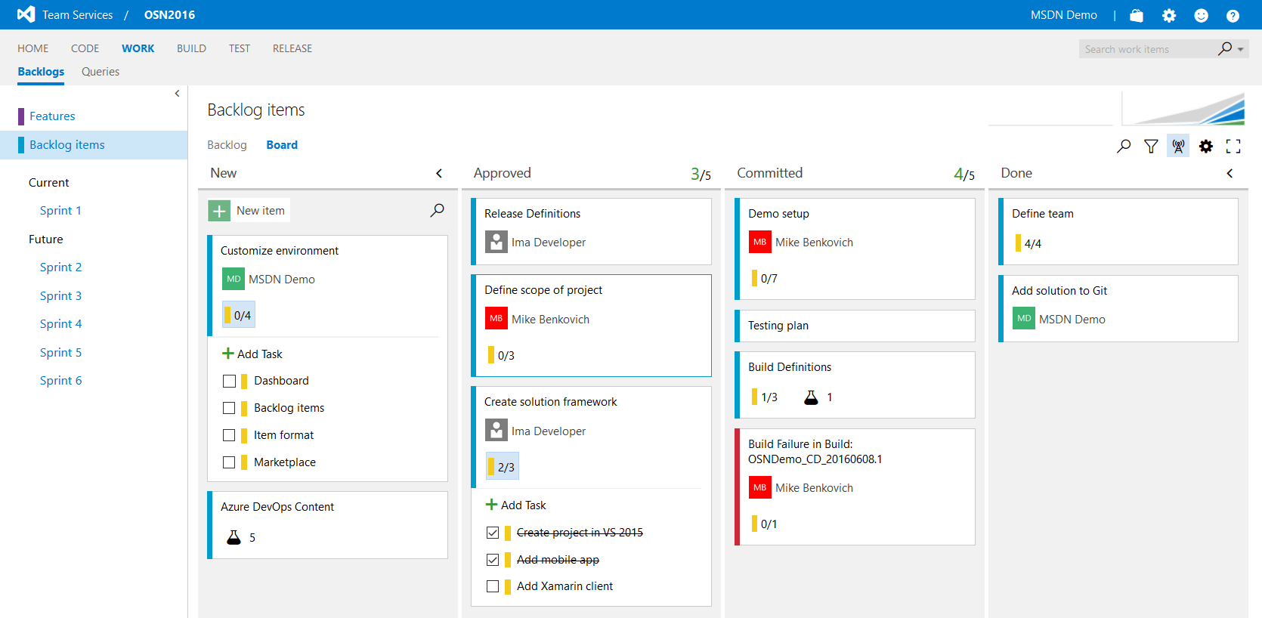
Project Backlog
Project Backlog Items
Quickly add items, bugs and tasks
Order by priority in list
Add to sprint by click and drag
Kanban Board
Manage work in progress
Visualize who’s working on what
Add rich content and descriptions
Tasks and Tests

Slide 108
Enable Agile
Dashboards & Charts
Backlogs & KanBan Boards w/ formatting
New Work Item Form
Social workflows with @mentions
Customizable Agile Processes
Dev+Test integration

Slide 109
Agile Commandments
Thou shall keep your code in a repository
Thou shall automate the build
Thou shall keep the build fast
Thou shall automate deployment
Thou shall make build self testing
Thou shall test in a clone of the production environment
Thou shall commit to the main branch every day
Thou shall build every commit
Thou shall make it easy to get the latest version
Thou shall easily see the result of the latest build

Slide 110
Byron’s Amendments
Thou shall roll forward, never roll back
Thou shall be data driven
Thou shall listen to your partners, clients, users
Thou shall roll with the punches
Thou shall not be afraid to break stuff
Thou shall be confident in your ability to fix it fast
Source: Bryan Tardif’s talk at Ignite

Slide 111
Dev Ops Basics
2) Code Repository
3) Build
4) Test
5) Deploy to Cloud
Contoso App
1) Developers
Azure
6) Monitor and Improve
©2017 LearnNow, LLC All Rights Reserved.

Slide 112
3C - Code

Slide 113
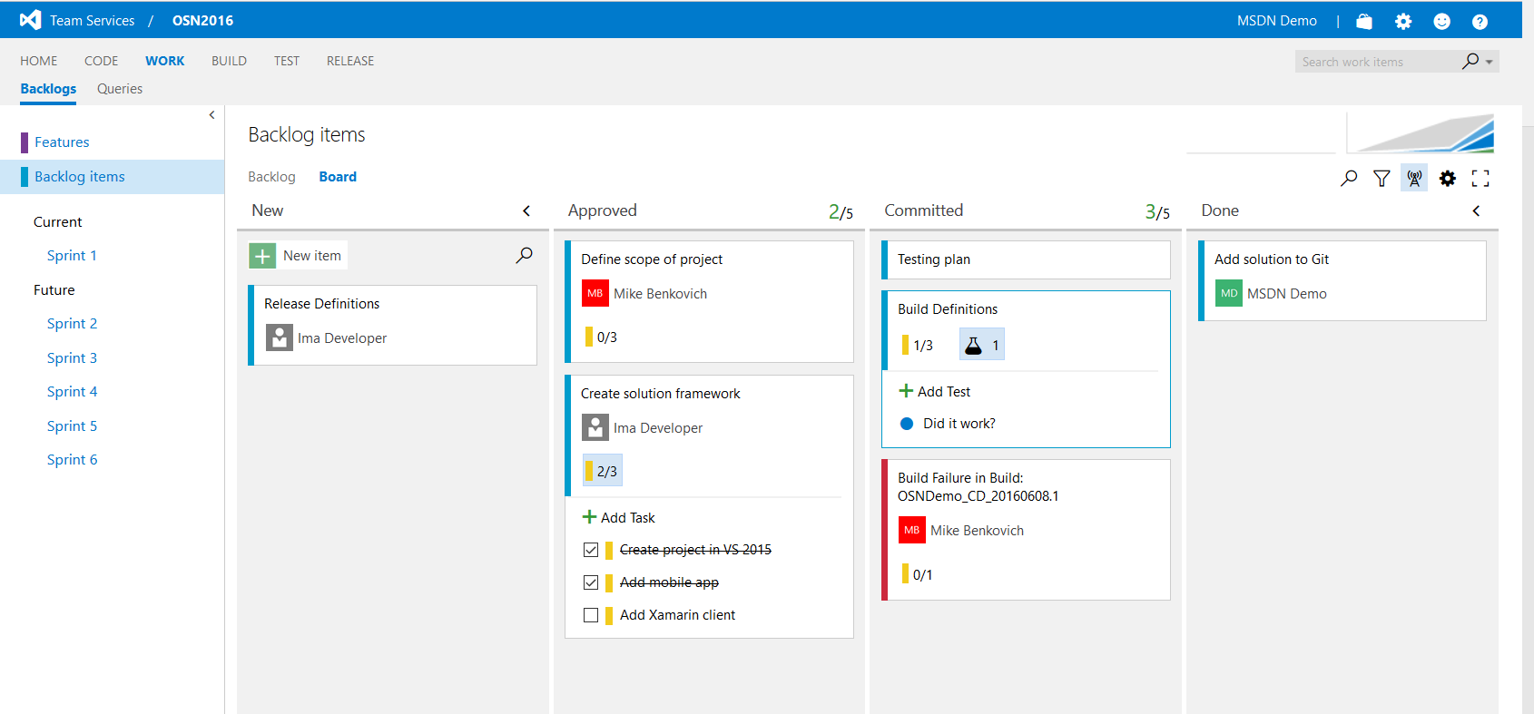
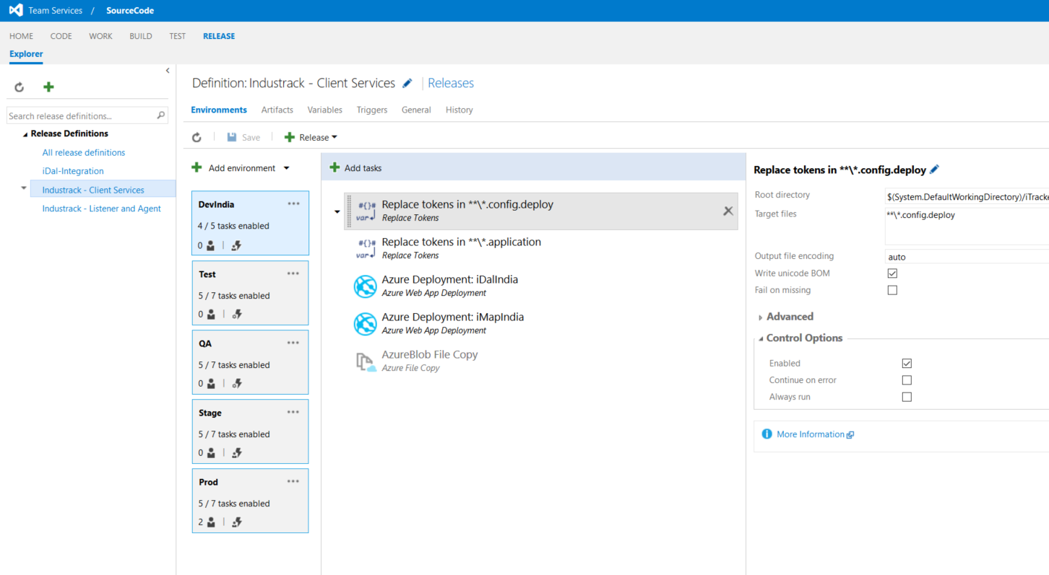
Visual Studio Team Services
Version Control
Git and TFS Version Control
Unlimited private repos
Agile Planning
Work item tracking
Kanban, backlogs, taskboards
Continuous Integration
Cloud-hosted build agents
Build support for all mobile platforms
Integration with test clouds

Slide 114
Code Management
End to End DevOps Traceability
Cross-platform with IDE plug-ins
Social Code Reviews
Semantic Code Search
Seamless Integration with Visual Studio

Slide 115
3D - Build

Slide 116
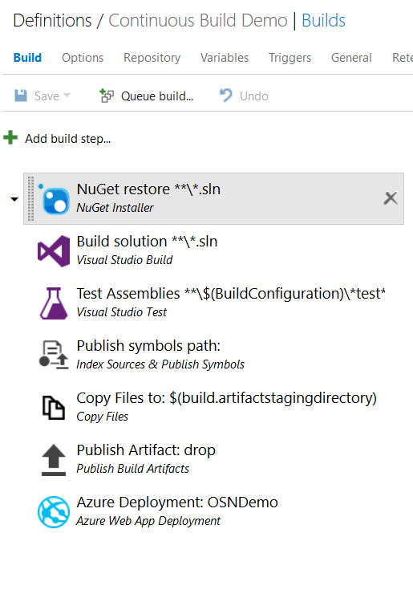
Define Automated Build
Build Tasks
Cross platform
Extendible
Trigger on check-in
Cloud based load testing
Packaging, NPM, NuGet, etc.
Xamarin support
HockeyApp
More!

Slide 117
3E - Release

Slide 118
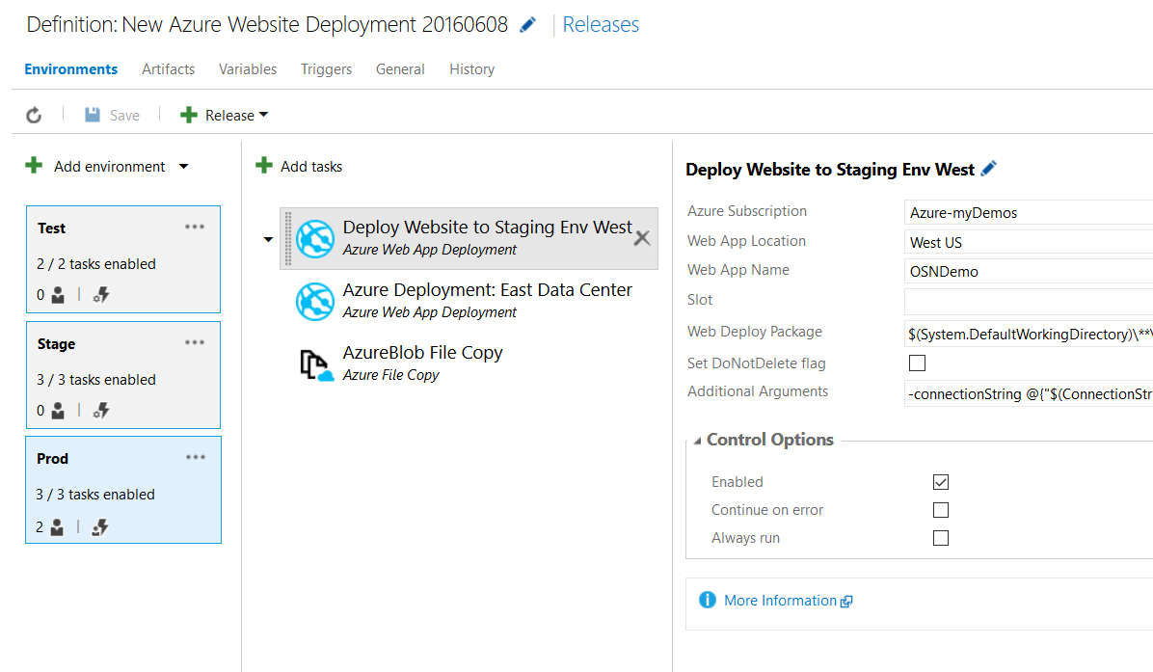
Release Management
Enables Continuous Delivery
Parallel deployments
Deploy to Cloud, on-premises data centers
Integration and traceability throughout Team Services
Coming to TFS in Update 2

Slide 119
3F - Test

Slide 120
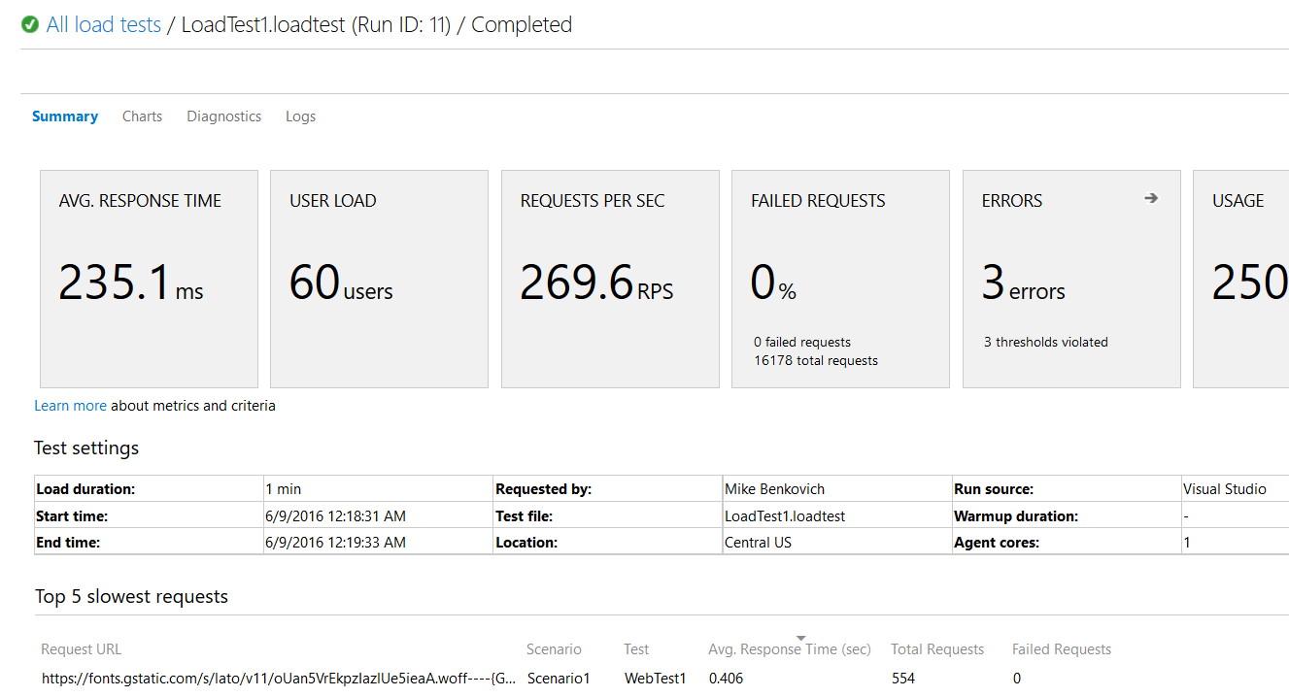
Test Automation
Full integration with Build and Release Management
Code Coverage support for Java
Parallel Execution
Exploratory Extension

Slide 121
Conclusion

Slide 122
4A – Mobile Apps

Slide 123
Engaging Mobile Apps
Build engaging mobile apps for iOS, Android, and Windows
Easily add corporate sign-on, and securely connect to on-premise resources
Create robust apps that remain useful when there are network issues, so users can create and modify data even when they are offline
Broadcast personalized push notifications to millions in minutes

Slide 124
Mobile Apps NuGet enables
Identity
Offline Data Sync
Push Notifications
Client SDK’s

Slide 125
4B – API Apps

Slide 126
API Apps That Connect
Quickly build and consume APIs in the cloud using the language of your choice
Secure APIs with Active Directory, single sign-on, and oAuth
Generate client proxies or APIs in your language of choice
Mashup existing enterprise APIs
Integrate with API Management and Logic Apps

Slide 127
4C – Logic Apps

Slide 128
Workflow Logic Apps for Integration
Create business processes and workflows visually
Deliver integration capabilities in web, mobile, and API apps
Integrate with your SaaS and enterprise applications
Automate EAI, B2B, and business processes
Connect to on-premises data

Slide 129
4D – WebJobs & Fns

Slide 130
WebJobs and Functions
Run business logic
Triggered by time or by events
Enable processing of background work

Slide 131
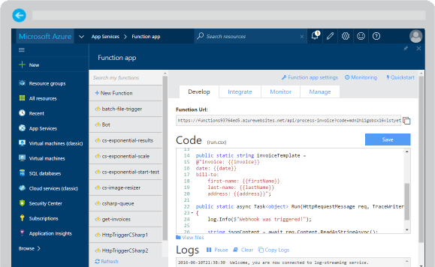
Azure Functions
Create a “serverless” event-driven experience that extends the existing Azure App Service platform by building “nanoservices” that can scale based on demand
Notes:
Azure Functions are part of the Azure Web + Mobile suite of App Services and are designed to enable the creation of small pieces of meaningful, reusable methods, easily shared across services. These serverless, event-driven methods are often referred to as “nanoservices” due to their small size. Although an Azure Function can contain quite a bit of code, they are typically designed to serve a single purpose, and respond to events in connected services.

Slide 132
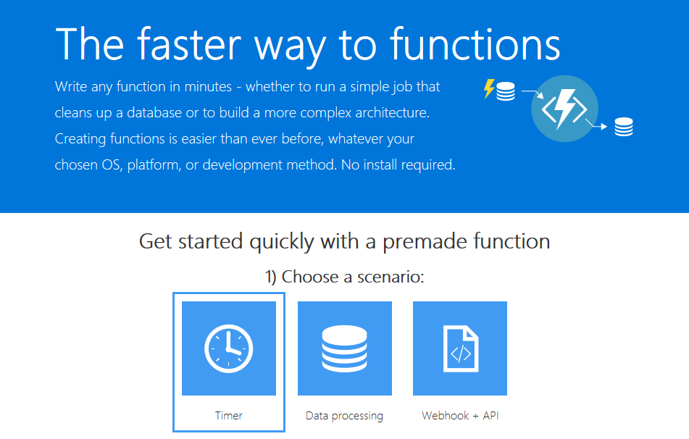
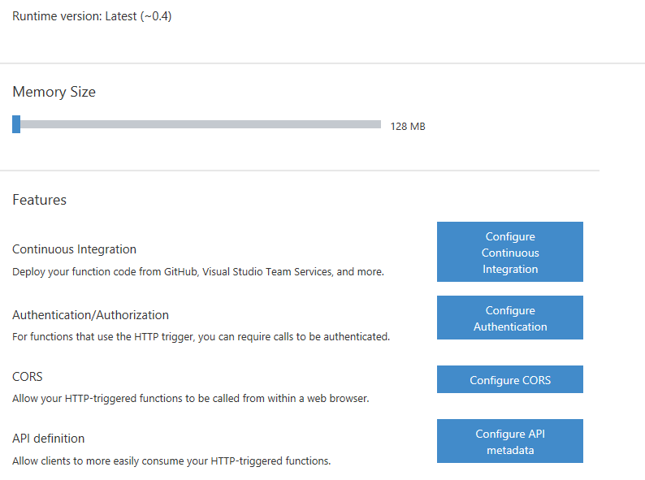
Supported Languages and Tools
Create functions in JavaScript, C#, Python, and PHP, as well as scripting options such as Bash, Batch, and PowerShell, that can be triggered by virtually any event in Azure, 3rd party services, or on premise systems
Notes:
Azure Functions can be created in most common development and scripting languages, and can be “triggered” by events in other Azure App Services, such as Web, Mobile, Logic, and API apps. Azure Functions can also be exposed via HTTP URL schemes for easy integration into legacy systems.

Slide 133

Common Scenarios
Your App or Service
Timer-based processing
Azure service event processing
SaaS event processing
Serverless web application architectures
Serverless mobile backends
Real-time stream processing
Real-time bot messaging
Office 365
Office Graph
Azure Storage
Legacy Systems
Web Services
Other Functions
Notes:
Azure Functions are “event-driven” meaning they run based on associated and configure events, or “triggers”. For example an Azure Function could be triggered by a simple timer, such as running a process once every 24-hours, or triggered by an event in a document management system, such as when a new document is uploaded to a SharePoint library. Azure Functions can also respond to Azure-specific events, such as an image added to a Storage Blob or a notification arriving in a Message Queue.

Slide 134
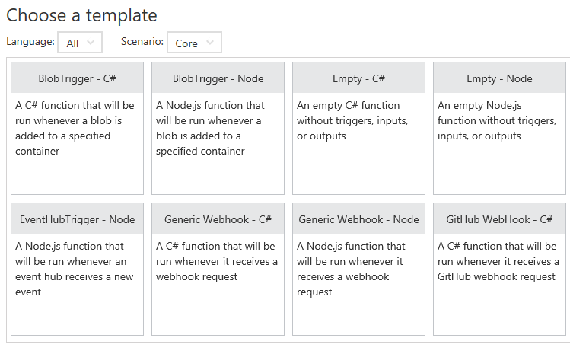
Function App Templates
Function App templates are categorized into general areas of Timer, Data Processing, and Webhook & API
BlobTrigger
EventHubTrigger
Generic webhook
GitHub webhook
HTTPTrigger
QueueTrigger
ServiceBusQueueTrigger
ServiceBusTopicTrigger
TimerTrigger
Blank & Experimental
Notes:
Although Azure Functions can be created from scratch”, the Azure Portal exposes a large number of ever-growing templates to help get developers started. These templates are typically designed with specific triggers in mind, such as a Blob Storage event, or a GitHub webhook event. Templates can easily form the basis for robust function creation, and are really designed just to get a developer started.

Slide 135
Timer Function Apps
Run at explicitly specified intervals, like every day at 2:00 am using CRON expressions, like “0 */5 * * * *“ (every 5 minutes)
Can send information to other systems, but typically don’t “return” information, only write to logs
Great for redundant cleanup and data management
Great for checking state of services
Can be combined with other functions
Notes:
Timer Functions are exactly what they sound like: Functions triggered by a specific time event. Timer Functions are perfect for clean up and maintenance processes and can easily be combined with other functions for more robust scenarios. Timer Functions us CRON expressions to configure schedules. It’s a good idea to get familiar with CRON syntax, but in the meantime there are a number of tools online to help you build CRON expressions.

Slide 136

Data Processing Function Apps
Run when triggered by a data event, such as an item being added to a queue or container
Typically have in and out parameters
Great for responding to CRUD events
Great for performing CRUD events
Great for moving content
Access data across services
Notes:
Data Processing Functions are triggered by activity in a datastore, such as a table, queue, or container. Data Processing Functions also typically have both “in” and “out” parameters, meaning they can accept an object as a parameter, and then process information and then return another object from within the function. This is not the same as a “return” value, as most Azure Functions either return void, or an HTTP response such as “created”, “accepted”, or “OK”.

Slide 137
Webhook & API Function Apps
Triggered by events in other services, like GitHub, Team Foundation Services, Office 365, OneDrive, Microsoft PowerApps
Takes in a request and sends back a response
Often mimic Web API and legacy web services flows
Typically need CORS settings managed
Best for exposing functionality to other apps and services
Great for building Logic Apps
Notes:
Webhook and API Functions are designed to easily integrate with 3rd party systems, like GitHub, Office 365, and especially Microsoft PowerApps. Since Webhook and API Functions are often exposed to external or legacy systems, they typically need CORS settings managed in order to “allow” external resources to “see” and execute the function. Most Azure Logic Apps leverage Webhook and API Functions directly.

Slide 138
Anatomy of a Function
A “Run” file that containing the function code
A “Function” file containing all service and trigger bindings and parameters
A “Project” file containing project assembly and NuGet package references
App Service settings, such as connection strings and API keys
code
Executable code
Function configuration
.NET Core and Project references
Notes:
An Azure Function is really a group of a few files that work in harmony. All actual function logic resides in a “Run” file written in a language of choice. A “Project” file is similar to a project file in other technologies such as .NET Core or Universal Windows Platform and contains “secondary” assembly references such as NuGet packages. Finally a “Function” file contains information about triggers and parameters, such as locations of Storage Queue connection strings and whether the parameter is design as an “in”, “out” or “bi-directional”. Optionally, additional configuration is also found in the Function App Settings such as an API Key or database connection string.

Slide 139
Function Bindings
Bindings serve as the basis for all connections to and from a function. Many bindings can be “bi-directional” as well.
Type | Service | Trigger | Input | Output
Schedule | Azure Functions | ✔
HTTP (REST or webhook) | Azure Functions | ✔ |  | ✔*
Blob Storage | Azure Storage | ✔ | ✔ | ✔
Events | Azure Event Hubs | ✔ |  | ✔
Queues | Azure Storage | ✔ |  | ✔
Tables | Azure Storage |  | ✔ | ✔
Tables | Azure Mobile Apps |  | ✔ | ✔
No-SQL DB | Azure DocumentDB |  | ✔ | ✔
Push Notifications | Azure Notification Hubs |  |  | ✔
Notes:
Without bindings, an Azure Function would just be a “disconnected” algorithm without any way to serve a purpose. Bindings server to connect functions and output to other services. Some of the most common binding types and features are listed in the table, however variations and adaptations can and do exist.

Slide 140

Testing Functions
Command-line tools
3rd party products such as Postman and Swagger
Direct web calls via cURL
Nested functions
Microsoft Azure Storage Explorer
Visual Studio Cloud Explorer
Notes:
Many Azure Functions are exposed via an actual URL that can be called directly from a web client or browser. When an Azure Function is not exposed via a URL its common practice to call the function from another dunction, such as a Timer-based Function for testing purposes only. Since Azure Functions can be nested, testing scenarios can be quite varied. For managing and testing Azure Functions that integrate with Storage Containers, Microsoft provides the Microsoft Azure Storage Explorer, as well as the Visual Studio Cloud Explorer. The Logs console in the Azure Function Designer is also a great way to view and trace function processing.

Slide 141
Functions

